Slide 1


Entry Task:
Welcome!
Log on to your computer
Log in to Naviance
Think about the following and be prepared to answer:
  How many credits do you need to graduate?
  How many credits an you have earned at the end of each semester?
Username: district ID#
Password: district password
HSBP GR 8 Transition Lesson

Slide 2
Planning for High School & Beyond
Naviance Student
HSBP GR 8 Transition Lesson

Slide 3
What 9th graders need to know…

Slide 4
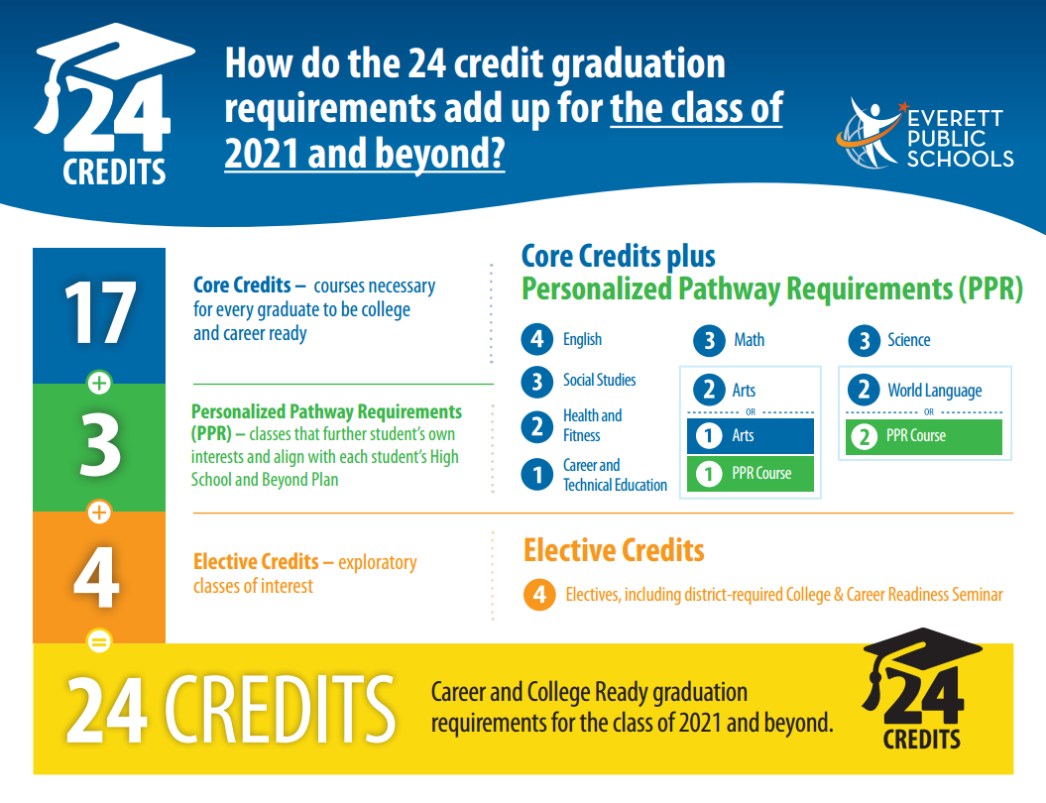
HSBP GR 8 Transition Lesson

Slide 5
Know Your Graduation Requirements!
+
+
English
4.0 credits
Math
3.0 credits
Science
3.0 credits
+
+
Social Studies
3.0 credits
Health
0.5 credit
PE
1.5 credits
+
+
CTE
1.0 credit
CCRS
0.5 credit
Electives
3.5 credits
+
= 24
World Language
2.0 credit
Fine Arts
2.0 credit

Slide 6
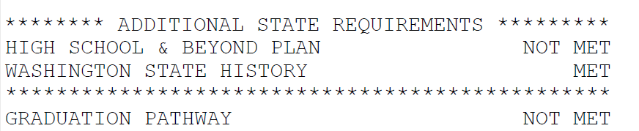
Your High School & Beyond Plan
Your High School & Beyond Plan is a graduation requirement.
Shows up on your official transcript as MET
Complete the short survey in Naviance each year through grade 12.
HSBP GR 8 Transition Lesson

Slide 7
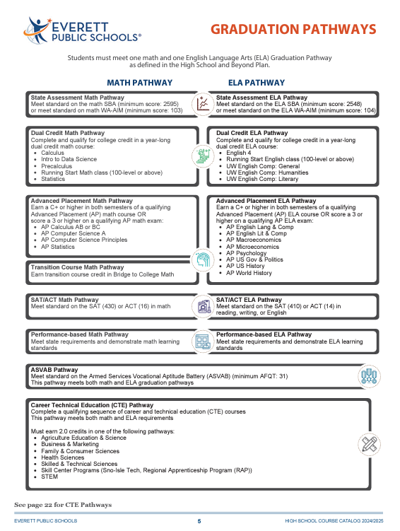
What is a graduation pathway?

Slide 8
What does it all mean? Terms to Know!
Term | Definition
Core Credits | Courses every student needs to take to be college and career ready.
Credit | What you earn for passing a class. One semester-long class earns 0.5 credit. Credits are posted to your official transcript.
CTE | Career and Technical Education (CTE) prepares students for the work force and some classes offer the option of earning college credit, such as tech prep courses.
Elective | Any exploratory classes of interest taken beyond the core credit classes that you will need to graduate from high school.
Fine Arts | Courses that are found in the category of fine arts and can be taken anytime throughout high school.
GPA | Grade point average is the average of all your class grades based on your academic performance. By adding up the individual point value for each grade and dividing by seven you calculate your GPA.
Health & Fitness | Fitness courses are any Physical Education (PE) class in high school. You will also need to take one semester of health.
Post-Secondary | College and/or career plans after high school graduation
Transcript | An official record of all your grades and credits.
World Language | To be eligible for entrance into a four-year university and high school graduation, you need two consecutive years of the same language.
PPR | Classes that further a student’s own interest and aligns with their High School and Beyond Plan and future career plans.
HSBP GR 8 Transition Lesson

Slide 9






District High Schools
Everett High School | Cascade High School | H. M. Jackson High School | Sequoia High School
Additional High School Options:
*Click each button to be taken to the school website.
HSBP GR 8 Transition Lesson

Slide 10
How Do I Know what classes to take?

Slide 11
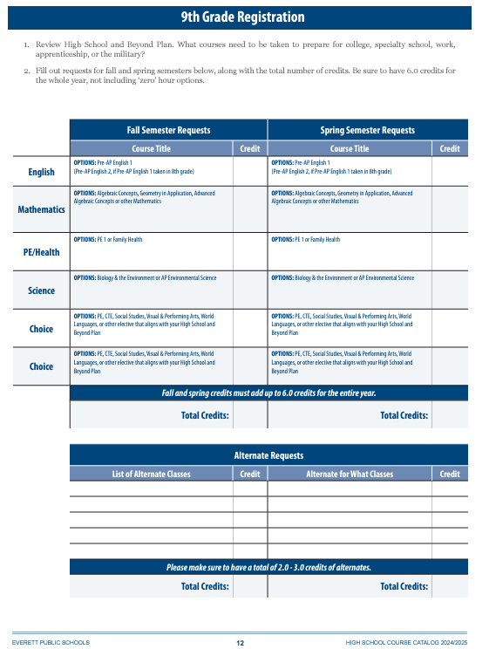
Options & Choices
With the 24 credit graduation requirement, there are options for the required classes you take and many choices for classes based on your personal interests.
The following 5-step process will help you complete this 9th grade registration sheet.
HSBP GR 8 Transition Lesson

Slide 12
Exploring Your 9th Grade options

Slide 13
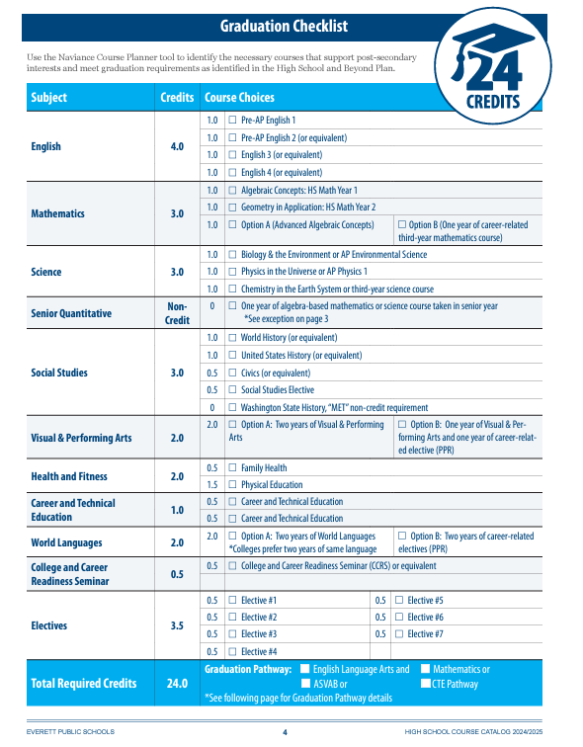
Step 1: Graduation Checklist
Using the graduation checklist…
check off the classes you will take in 9th grade
check off the classes you have taken in 8th grade for high school credit.

Slide 14


Step 2: Course Catalog
Use your Course Catalog, to explore all the different choices for elective classes.
You can take in 9th grade and add the class names to your Graduation Checklist.
Names of the courses and
descriptions are found in the
course catalog.
HSBP GR 8 Transition Lesson

Slide 15
Step 3: Create Your Plan
Use the paper copy of your 9th Grade Registration form to write in your courses.
Make sure to choose 3-4 credits worth of alternates in case your chose elective is not available.
*Note: Year-long classes = 1.0 credit Semester log classes = 0.5 credit
HSBP GR 8 Transition Lesson

Slide 16


Step 4: Enter Course Requests in HAC
Log in to your Home Access Center account
On your school website click
Next, click
Click the link to Home Access Center then log in with your student ID and password.
Using your 9th Grade Registration form, you can enter your course requests in HAC.
HSBP GR 8 Transition Lesson

Slide 17

Step 5: Complete Your 8th Grade HSBP
Your High School & Beyond Plan Survey is about your future plans.
Each year you can revise your answers on the survey as your interests and/or goals might change
Access the survey, go to Planner > Tasks
Click the survey title Complete My High School & Beyond 8th Grade Year
HSBP GR 8 Transition Lesson

Slide 18
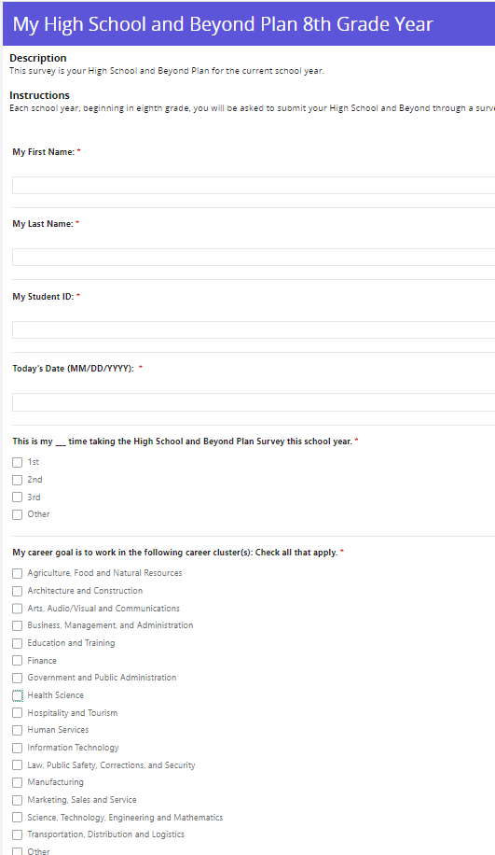
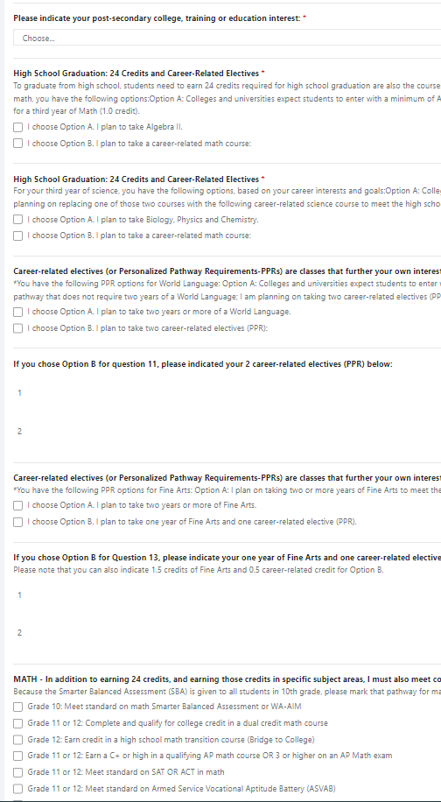

8th Grade HSBP Survey
Check with your counselor if you have questions
When the survey is complete click
Lesson Video for HSBP Survey
(*Start @ 8:07)
HSBP GR 8 Transition Lesson

